Slide 1

Central Limit Theorem
ML LABS PVT LTD || WWW.ANALYTICS6.COM || DATA SCIENCE , AI , ML ,COMPUTER VISION || TRAINING AND CONSULTING
Phone Number : 91-6362546088 || Email : contact@analytics6.com

Slide 2
What is central limit theorem?
The central limit theorem states that if you have a population with mean μ and standard deviation σ and take sufficiently large random samples from the population with replacement , then the distribution of the sample means will be approximately normally distributed.
ML LABS PVT LTD || WWW.ANALYTICS6.COM || DATA SCIENCE , AI , ML ,COMPUTER VISION || TRAINING AND CONSULTING
Phone Number : 91-6362546088 || Email : contact@analytics6.com

Slide 3

Central Limit Theorem
One of the most important theorem in statistics and probability theory is the central limit theorem.
Most widely used in statistics
It’s usefulness lies in its simple definition.
ML LABS PVT LTD || WWW.ANALYTICS6.COM || DATA SCIENCE , AI , ML ,COMPUTER VISION || TRAINING AND CONSULTING
Phone Number : 91-6362546088 || Email : contact@analytics6.com

Slide 4
Central limit Theorem
In other words, there is no need to know very much about the actual distribution of
the variables , as long as there are enough instances of them – their sum can be treated as normally distributed.
ML LABS PVT LTD || WWW.ANALYTICS6.COM || DATA SCIENCE , AI , ML ,COMPUTER VISION || TRAINING AND CONSULTING
Phone Number : 91-6362546088 || Email : contact@analytics6.com

Slide 5
To apply the CLT:
If the population distribution is normal, any sample size can be used.
If the population distribution is not normal, then n > 30.
The distribution can be converted to standard scores provided that the sample size is large.

Slide 6
Importance of the central limit theorem
The data must follow the randomization condition. [It must be sampled randomly]
samples should be independent of each other.[one sample should not influence the other samples]
Sample size should be not more than 10% of the population [when sampling is done without replacement]
The sample size should be sufficiently large.
ML LABS PVT LTD || WWW.ANALYTICS6.COM || DATA SCIENCE , AI , ML ,COMPUTER VISION || TRAINING AND CONSULTING
Phone Number : 91-6362546088 || Email : contact@analytics6.com

Slide 7
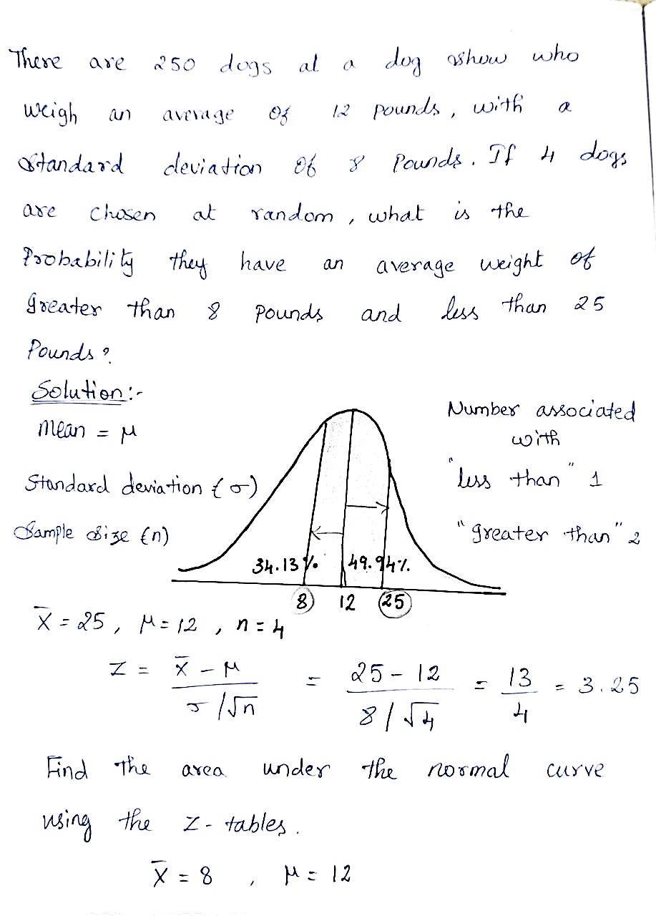
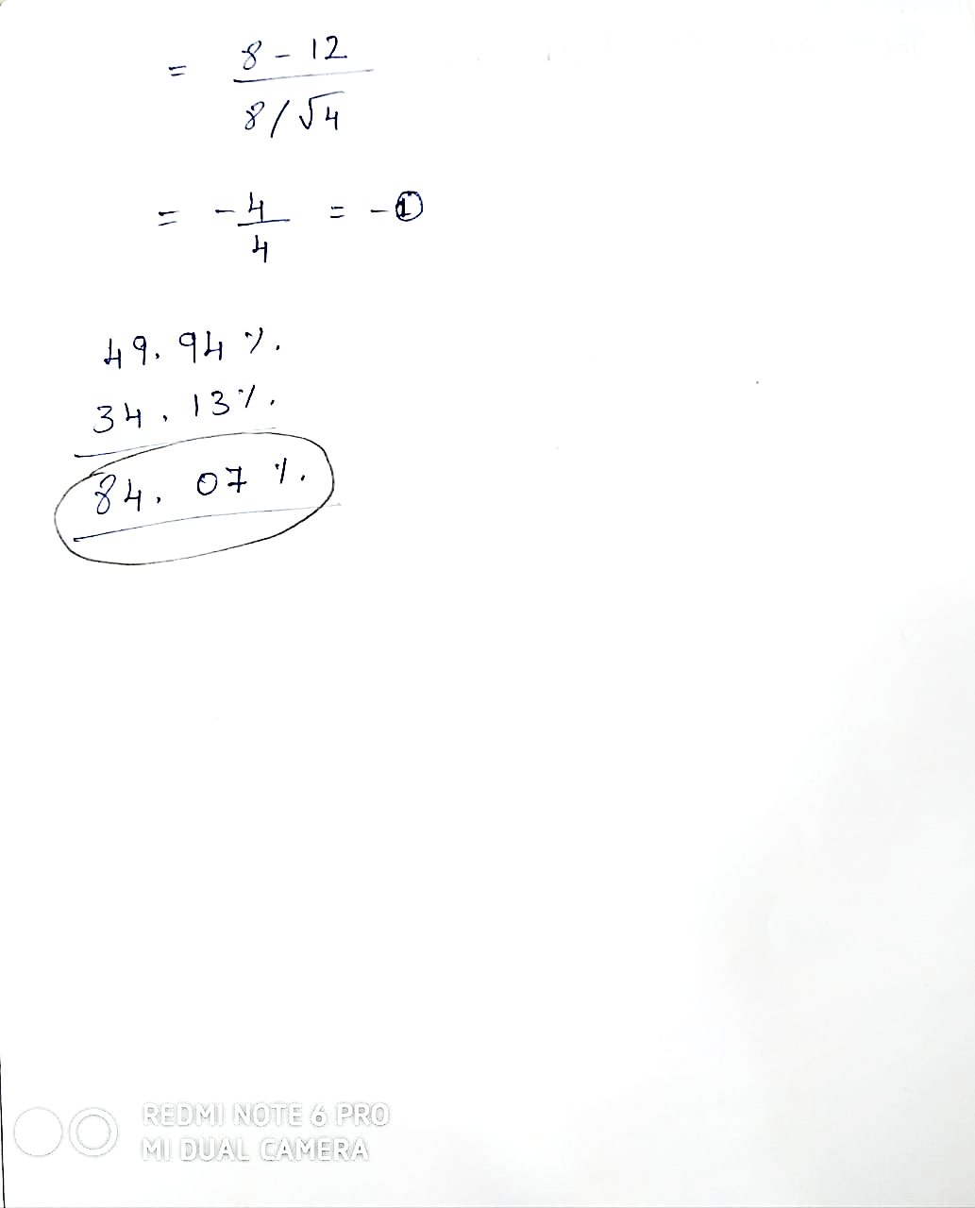
Example problem:
ML LABS PVT LTD || WWW.ANALYTICS6.COM || DATA SCIENCE , AI , ML ,COMPUTER VISION || TRAINING AND CONSULTING
Phone Number : 91-6362546088 || Email : contact@analytics6.com

Slide 8
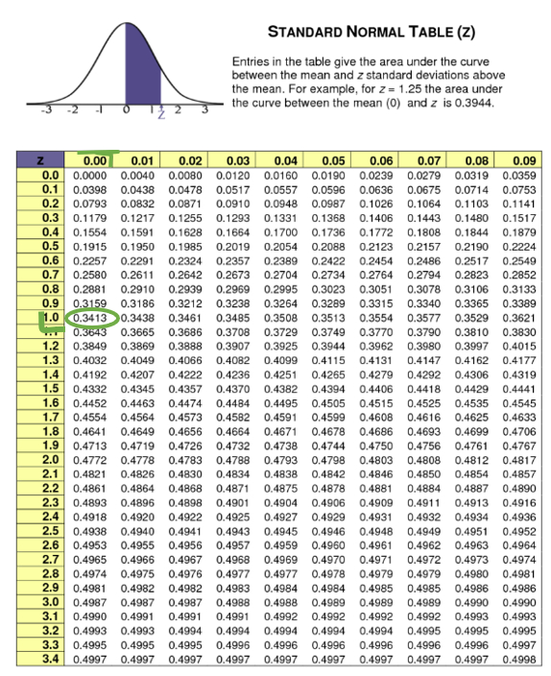
Z table
ML LABS PVT LTD || WWW.ANALYTICS6.COM || DATA SCIENCE , AI , ML ,COMPUTER VISION || TRAINING AND CONSULTING
Phone Number : 91-6362546088 || Email : contact@analytics6.com

Slide 9
Thank You
ML LABS PVT LTD || WWW.ANALYTICS6.COM || DATA SCIENCE , AI , ML ,COMPUTER VISION || TRAINING AND CONSULTING
Phone Number : 91-6362546088 || Email : contact@analytics6.com

